Slide 1
Target deconvolution project discussion
Jaber Valinejad, Qian Zhu
8-12-2024

Slide 2
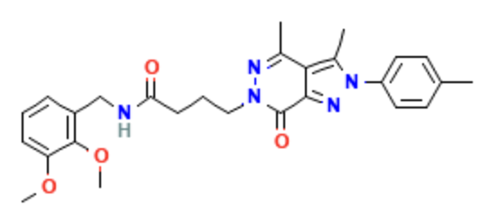


Compound CID: 16022698
Newly identified compounds
NCGC00602080-03
NCGC00685598-01
NCGC00685517-01
NCGC00686269-01
Similar compounds
Predicted genes
Literature search
Prediction
Literature search
Prediction
DYT1 dystonia

Slide 3
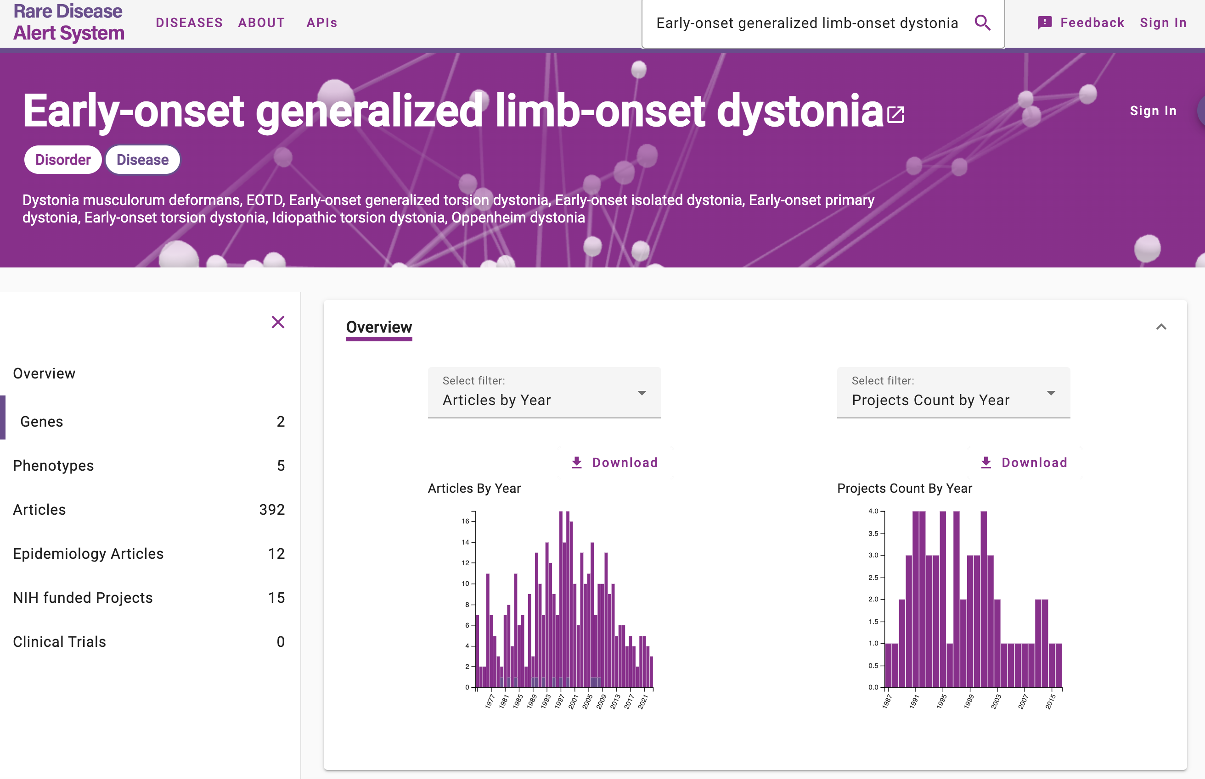

Slide 4
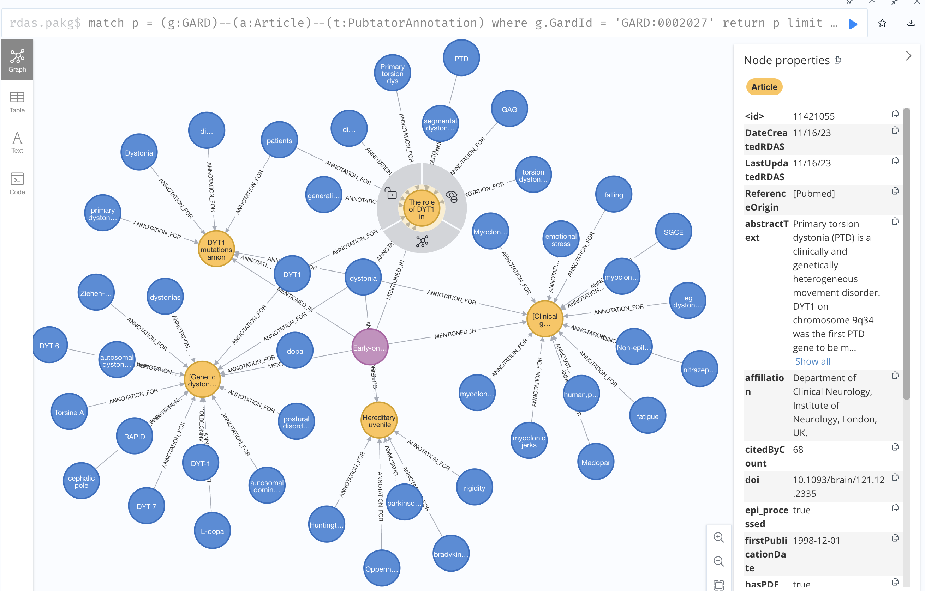

Slide 5
Target Deconvolution via Predicted Genes

Slide 6


Newly identified compounds
NCGC00602080-03
NCGC00685598-01
NCGC00685517-01
NCGC00686269-01
DYT1 dystonia
Literature search
Annotation checking
Number of papers
Concurrence on sentence level
Gene prediction
Pathway enrichment analysis
Enriched Pathways
ShinyGO

Slide 7
Gene Prediction Tools | Compounds | Number of Predicted genes
SwissTargetPrediction | NCGC00602080 | 100
 | NCGC00685598 | 100
 | NCGC00685517 | 100
 | NCGC00686269 | 100
Super-PRED | NCGC00602080 | 123
 | NCGC00685598 | 94
 | NCGC00685517 | 140
 | NCGC00686269 | 144
Predicted Genes for the Newly Identified Compounds
Gene Prediction Tool | Number of unique genes | Mean Probability | Mean Accuracy | Common Predicted Genes
SwissTargetPrediction | 151 | 0.107 | NA | DPP8 TERT MAOA YES1 PIK3CD BCHE HTR7 SLC6A9 AURKB CAPN1 LYN ACHE CSK CDK5 CACNA1B ABCB1 KIF11 TLR8 MAOB ITK FLT1 SLC6A5 TLR7 AHCY AXL PDGFRB CTSK IKBKB
Super-PRED | 190 | 0.6783 | 91.52%

Slide 8
DYT1 Dystonia related Publication Retrieval from RDAS
Methods | Searching Terms | References | # Papers
Retrieving articles based on the disease | Early-onset generalized limb-onset dystonia (GARD:0002027 ) | https://rdas.ncats.nih.gov/disease?id=GARD:0002027 | 404
Retrieving articles based on the searching terms presenting in the annotations | 'early-onset generalized torsion dystonia’ , 'tor1a dystonia’ , 'idiopathic dystonia dyt1’ , 'primary torsion dystonia’ , 'early-onset torsion dystonia’ , "oppenheim's dystonia“ , 'torsin a’ , 'early onset torsion dystonia’ , 'dyt1 dystonia’ , 'torsina’ , 'oppenheim dystonia’ , 'early-onset generalized dystonia’ , 'torsin-1a’ , 'tor1a’ , 'dyt1’ , 'dystonia 1’ , 'torsion (autosomal dominant; torsin a)’ , "oppenheim's dystonia“ , 'dyt1 early-onset isolated dystonia’ , 'early-onset torsion dystonia’ , 'dyt1’ , 'torsin family 1’ , 'dystonia musculorum deformans 1’ , 'dystonia musculorum deformans’ , 'dystonia 1, torsion, autosomal dominant’ , 'idiopathic torsion dystonia’ , 'early-onset generalized limb-onset dystonia’ , 'idiopathic torsion dystonia’ , 'dq2’ , 'early-onset primary dystonia’ , 'member a (torsin a)’ , 'dyt-tor1a dystonia’ , 'torsina’ , 'primary dystonias’ , 'early-onset torsion dystonia’ , 'eotd’ , 'dystonia 1’ , 'early-onset isolated dystonia' | https://rarediseases.org/gard-rare-disease/dyt-tor1a/ https://www.perplexity.ai/search/all-sysnonms-of-HxM_sfkuRRadls5XAskFeQ https://omim.org/entry/128100 https://www.orpha.net/en/disease/gene/TOR1A | 516
Retrieving articles based on the searching terms presenting in the Keywords |  |  | 48
Total |  |  | 692
-

Slide 9
Identification of genes with scientific evidence
ABL1
CACNA1B
NCGC00685517
CACNA1B
CTSD
NCGC00686269
NPC1
GCK
NCGC00602080
PDGFRB
PDGFRB
NCGC00685598
SLC2A1
ACHE
ACHE
via SwissTargetPrediction
via Super-PRED

Slide 10
Genes from SwissTargetPrediction | Co-occurrence in sentences | Literature Annotations
ABL1 | The deletion harbors more than 60 genes, including SPTAN1, DYT1/TOR1A, ABL1, ASS1, LAMC3, POMT1, DOLK, and GLE1, mutations in which have previously been associated with monogenic disorders. (22639460) | 1427899, 22639460
CACNA1B |  | 35041927
GCK |  | 28387648
PDGFRB |  | 20301334
ACHE | Accordingly, in Tor1a^{+/-} mice we measured a robust elevation in basal ACh content coupled to a compensatory enhancement of acetylcholinesterase (AChE) enzymatic activity. (34173686) | 34173686

Slide 11
Genes from Super-PRED | Co-occurrence in sentences | Literature annotations
CACNA1B |  | 35041927
CTSD |  | 20301334
NPC1 |  | 20301334
PDGFRB |  | 20301334
SLC2A1 | Combined dystonias (with parkinsonism or myoclonus) are further subdivided into persistent (GCHI [DYT5], SGCE [DYT11], and ATP1A3 [DYT12], with TAF1 most likely but not yet proven to be linked to DYT3) and paroxysmal (PNKD [DYT8], PRRT2 [DYT10], and SLC2A1 [DYT18]). 24092288 | 24262166, 24092288, 23893446, 22166420, 19685389, 19578124, 20301334
 | Finally, paroxysmal exertion-induced dystonia (DYT18, GLUT1 deficiency) is caused by mutations in the SLC2A1 gene (DYT9 and DYT18). 22166420
 | Other genes which have only recently been identified include: THAP1, causing adolescent-onset primary dystonia of mixed type (DYT6); ATP1A3, responsible for Rapid-Onset Dystonia-Parkinsonism (RDP, DYT12); PRKRA, causing young-onset dystonia-parkinsonism (DYT16); and SLC2A1, causing paroxysmal exertion-induced dystonia with haemolytic anemia (DYT18). 19685389
 | The disease gene has been identified in 10 primary dystonias, seven autosomal dominant (TOR1A/DYT1, GCH1/DYT5a, THAP1/DYT6, PNKD1/MR-1/DYT8, SGCE/DYT11, ATP1A3/DYT12 and SLC2A1/DYT18), two autosomal recessive (TH/DYT5b and PRKRA/DYT16) and one X-chromosomal recessive (TAF1/DYT3). 19578124
ACHE | Accordingly, in Tor1a+/- mice we measured a robust elevation in basal ACh content coupled to a compensatory enhancement of acetylcholinesterase (AChE) enzymatic activity. (34173686) | 34173686

Slide 12
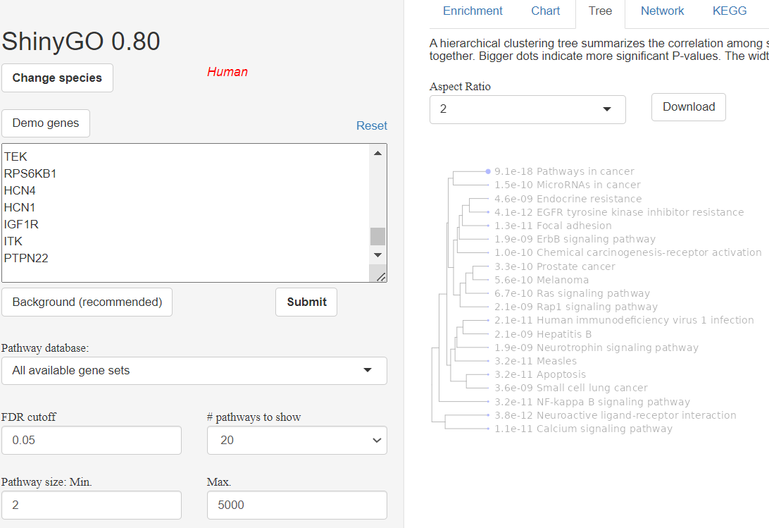
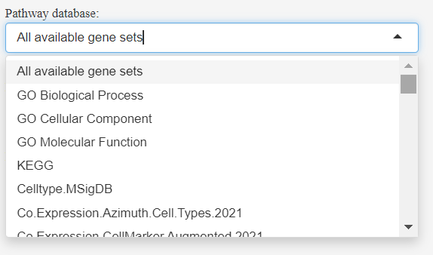
Enrichment Analysis - ShinyGO
False Discovery Rate (FDR) is calculated using the Benjamini-Hochberg method. FDR cutoff = 0.05 was applied in this study.
Fold Enrichment of a pathway is defined as the ratio of the percentage of genes in your list to the corresponding percentage in the background genes. Higher values indicate stronger enrichment and are an important metric of effect size.

Slide 13
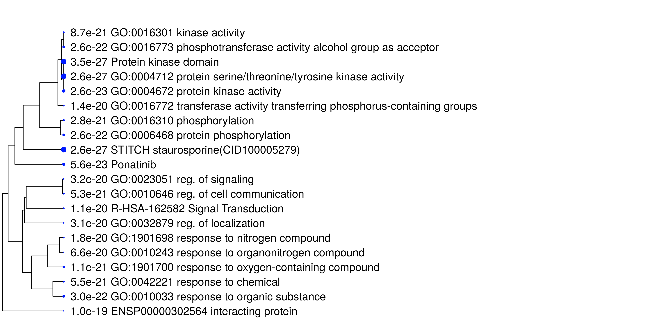
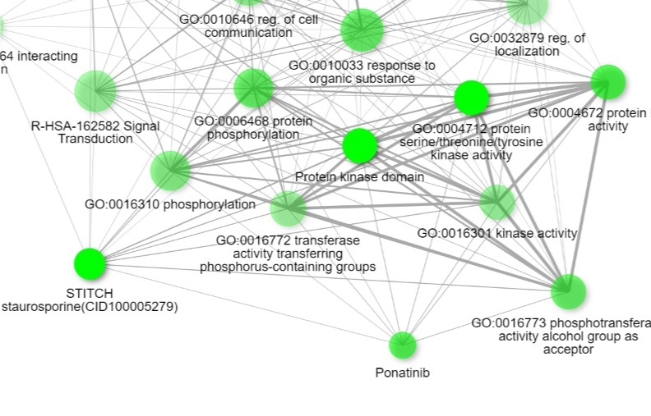
4,000 enriched biological terms are enriched for genes from SwissTargetPrediction
Biological Terms | Compounds | Predicted genes from SwissTargetPrediction
cell migration | NCGC00602080 | PDGFRB TEK ACKR3 PIK3CD CXCR3 HDAC1 FGFR1 PDGFRA AKT1 RET EPHB4 PSEN1 ABL1 RPS6KB1 PTPN22 PRKCI TERT NOD2 BCL2 SLC8A1 SRC LYN IGF1R IRAK4 PAK4 CDK1 YES1 LCK
 | NCGC00685598 | PIK3CB PDGFRB ACKR3 PIK3CD CCR8 CCR4 CXCR3 HDAC1 FGFR1 PDGFRA AKT1 RET EPHB4 PSEN1 ABL1 PRKCI TERT NOD2 BCL2 SRC PRKCQ IGF1R IRAK4 PAK4 CDK1 YES1 LCK
 | NCGC00685517 | FLT1 PDGFRB KDR ACKR3 CCR9 CCR8 CCR4 CXCR3 HDAC1 FGFR1 AKT2 TGFBR1 PDGFRA AKT1 PRKCA EPHB4 FLT4 ABL1 TERT CDK5 NOD2 BCL2 SLC8A1 SRC LYN PRKD1 PRKCQ ADIPOR1 PRKCD PAK4 CDK1 YES1
 | NCGC00686269 | FLT1 PDGFRB ACKR3 AXL CCR9 HDAC1 FGFR1 AKT2 PDGFRA AKT1 PRKCA EPHB4 ABL1 TERT NOD2 BCL2 SLC8A1 SRC LYN PRKD1 PRKCQ PRKCD IRAK4 PAK4 CDK1 YES1
NCGC00602080

Slide 14
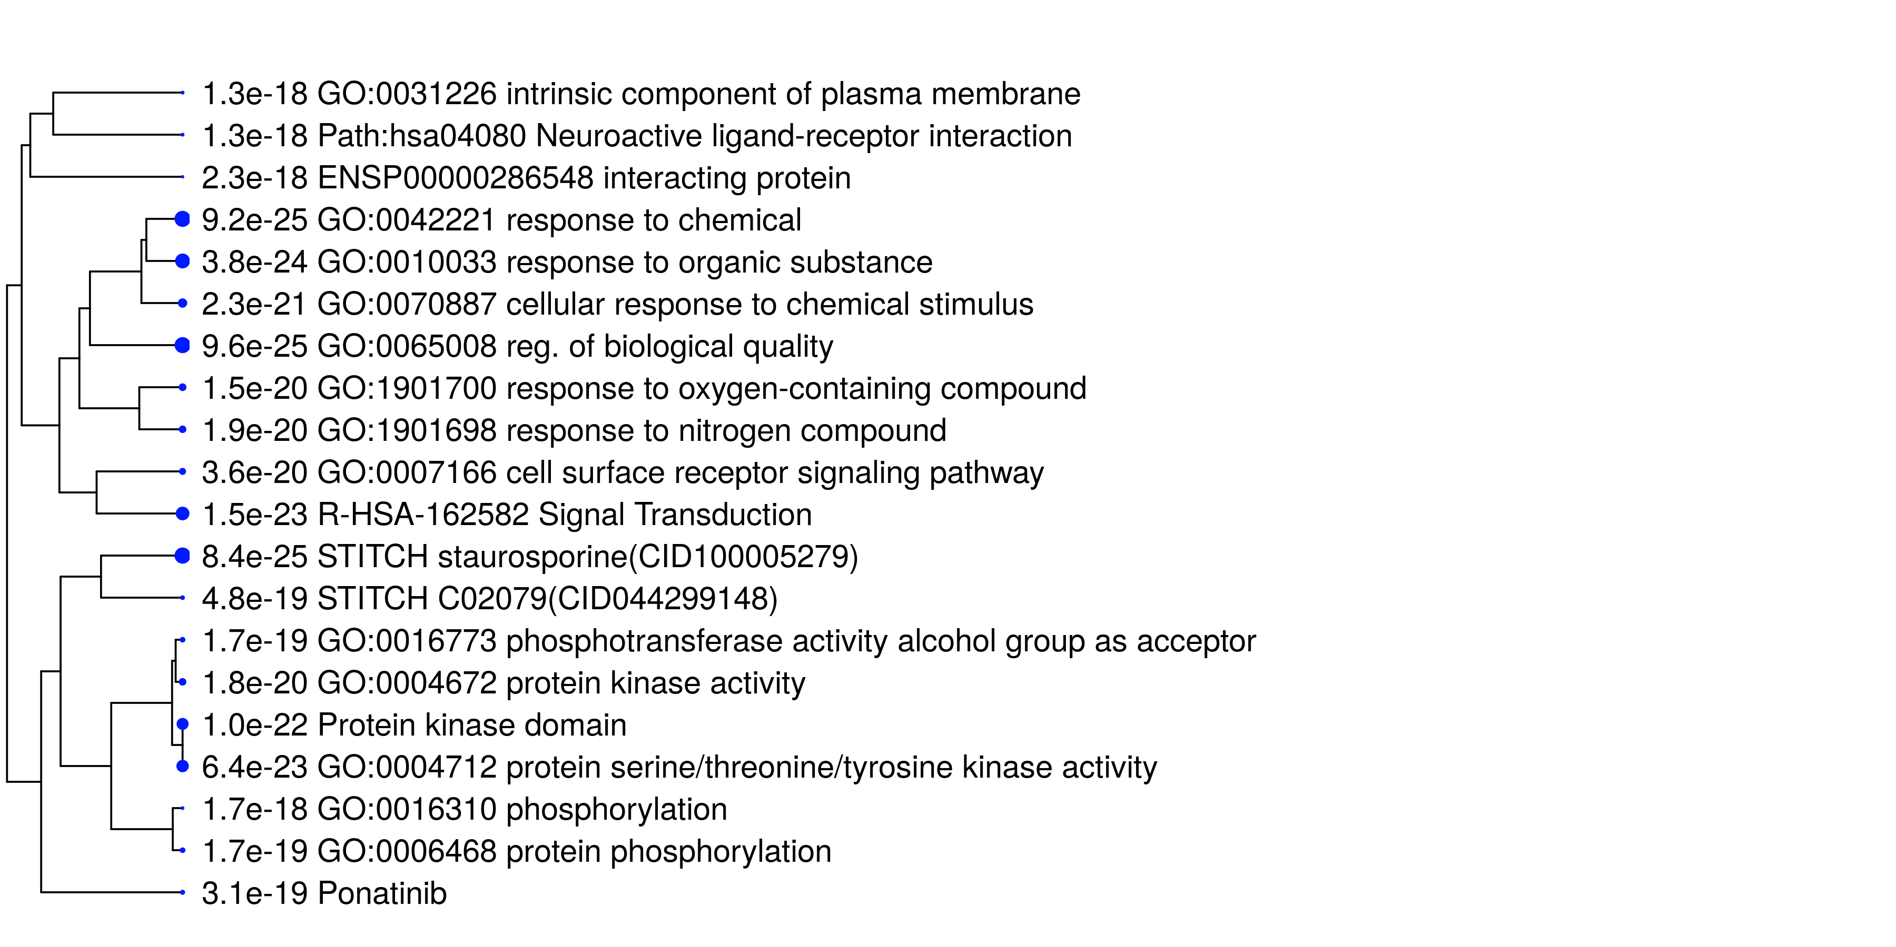
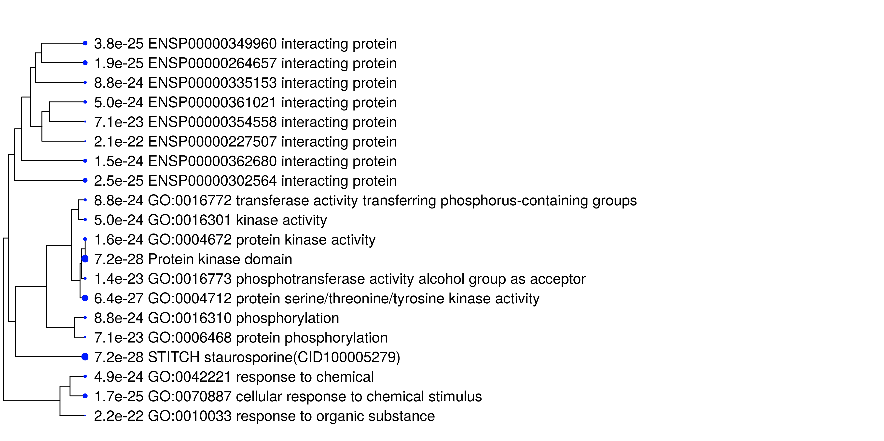
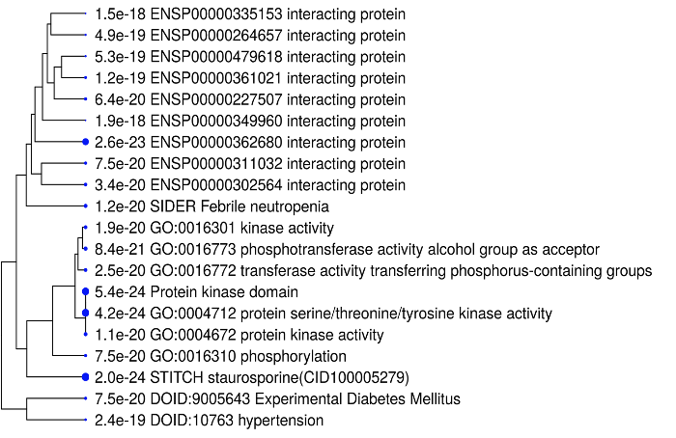
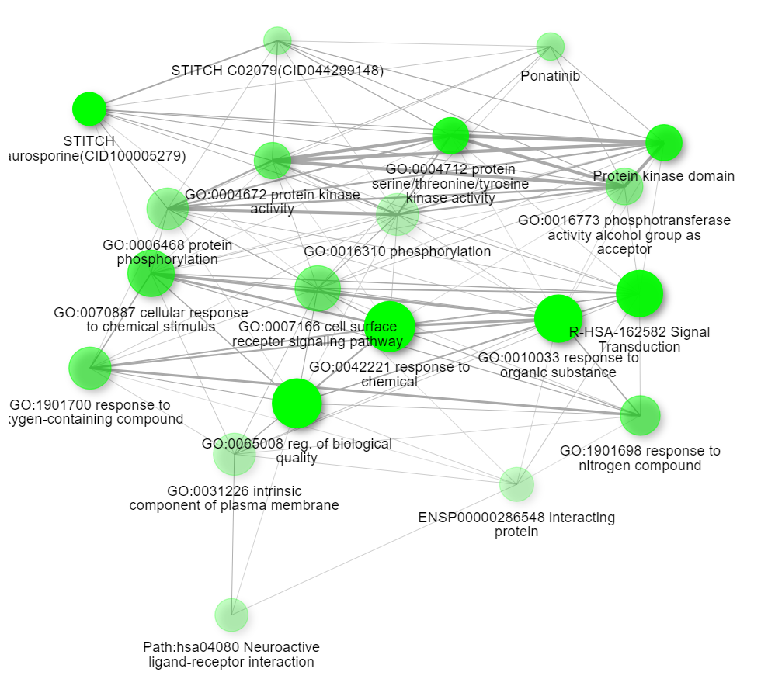
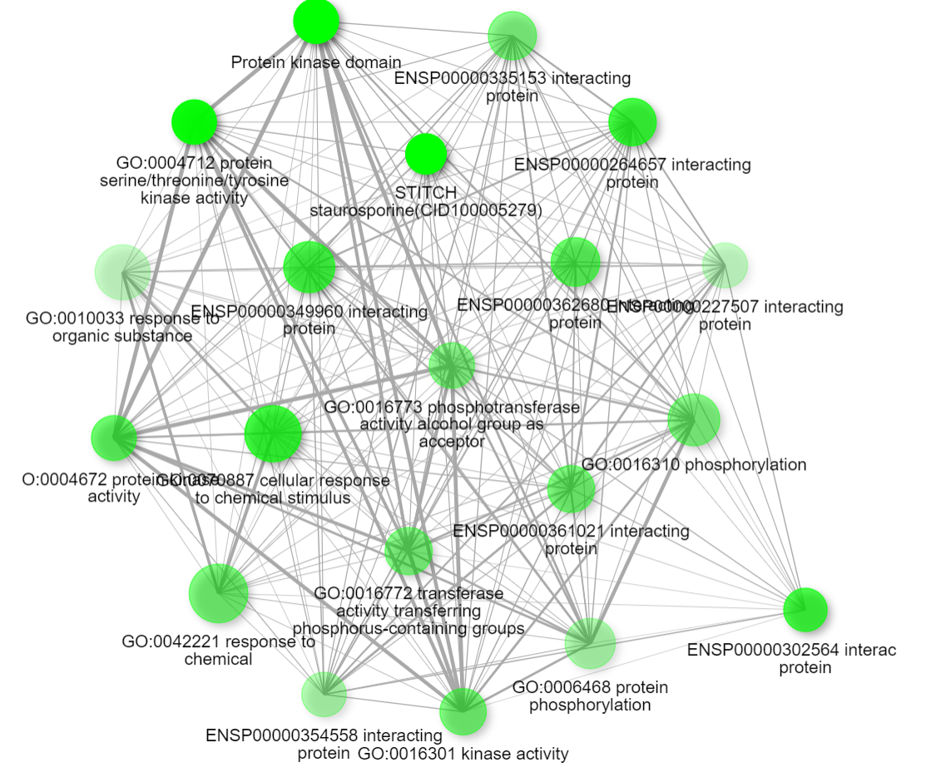
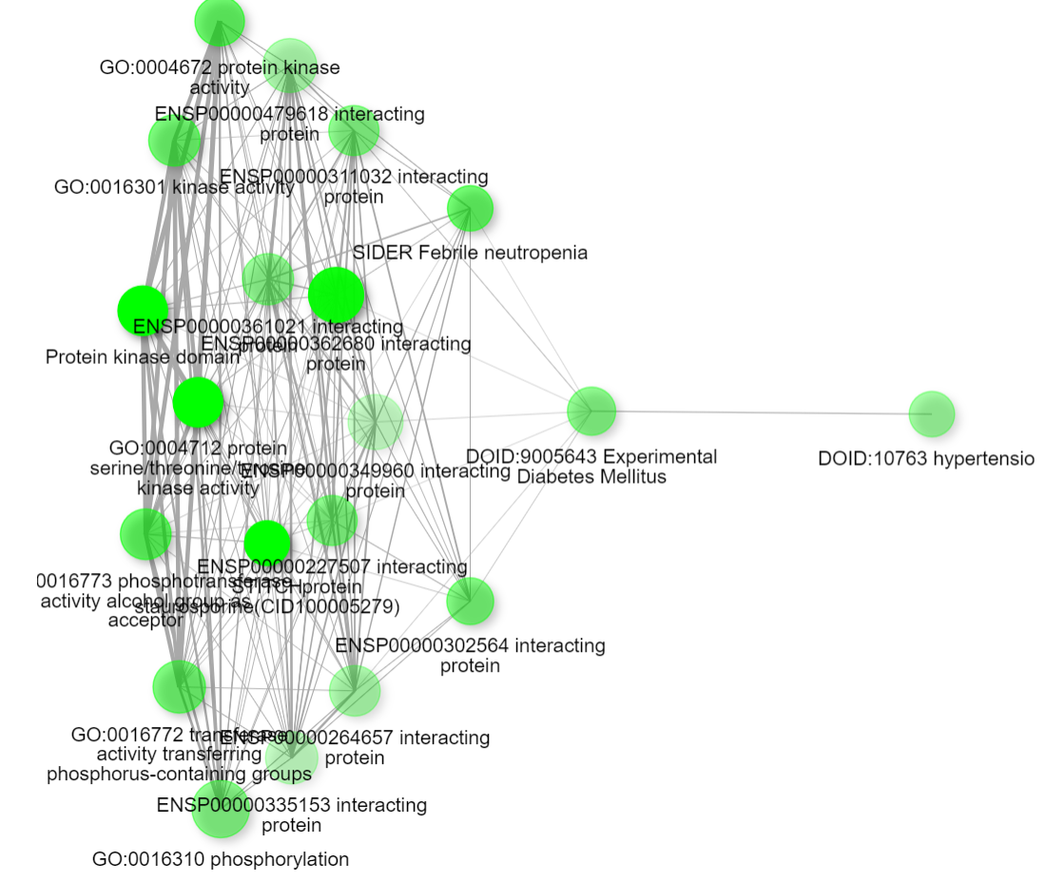
NCGC00685598
NCGC00685517
NCGC00686269
Protein kinase domain, protein serine/threonine/tyrosine kinase activity, and STITICH staurosporine are with the highest significant p values across all compounds

Slide 15
Top 12 Enriched Pathways based on Fold Enrichment
Enrichment FDR | Fold Enrichment | Pathways | Genes | Compounds
0.074564 | 124.3533 | Path:hsa00515 Mannose type O-glycan biosynthesis | LARGE1 | NCGC00685598
0.078806 | 110.5362 | Path:hsa00515 Mannose type O-glycan biosynthesis | LARGE1 | NCGC00686269
0.046768 | 90.43874 | Path:hsa00515 Mannose type O-glycan biosynthesis | LARGE1 | NCGC00685517
0.044017 | 90.43874 | Path:hsa00515 Mannose type O-glycan biosynthesis | LARGE1 | NCGC00602080
0.074564 | 89.37891 | Path:hsa04136 Autophagy-other | ATG4B | NCGC00685598
0.078806 | 79.44792 | Path:hsa04136 Autophagy-other | ATG4B | NCGC00686269
0.055008 | 65.00284 | Path:hsa04136 Autophagy-other | ATG4B | NCGC00602080
0.057725 | 65.00284 | Path:hsa04136 Autophagy-other | ATG4B | NCGC00685517
0.008972 | 61.17914 | Path:hsa04664 Fc epsilon RI signaling pathway | FYN LYN | NCGC00602080
0.005811 | 61.17914 | Path:hsa04664 Fc epsilon RI signaling pathway | FYN LYN | NCGC00685517
0.074564 | 47.66875 | Path:hsa05416 Viral myocarditis | FYN | NCGC00685598
0.078806 | 42.37222 | Path:hsa05416 Viral myocarditis | FYN | NCGC00686269
Mannose type O-glycan biosynthesis, Autophagy-other, Fc epsilon RI signaling pathway and Viral myocarditis are the most enriched biological terms.

Slide 16
Scientific evidence identification for the enriched biological terms
Biological Terms | Co-occurrence in sentences | Example of Co-occurrence in sentences
Signaling pathway | 22391119, 32289333, 25379658, 32289333 | The results suggest that molecular lesions of torsinA in Purkinje cells by gene therapy or intervening in the signaling pathway downstream of the cerebellar Purkinje cells may rescue motor symptoms in dystonia 1
cell migration | 18827015 | TorsinA-null MEFs had normal NE structure, but nuclear polarization and cell migration were delayed in a wound-healing assay, as compared with wild-type MEFs.
Phosphorylation | 11523564,33458877 | This deletion would remove 6 amino acids close to the carboxy terminus, including a putative phosphorylation site of torsinA.
muscle contraction | 2317008, 1867195, 34189496, 33468570, 23018676, 20223934,26183317, 23840813, , 36329866,19457118, 17129379, 21818381,24627482, 27448549, 33468570, 34189496, 24627482, 36329866, 26183317 | Idiopathic torsion dystonia (ITD) is a neurological disorder characterized by sustained muscle contractions that appear as twisting movements of the limbs, trunk, and/or neck, which can progress to abnormal postures.
Headache | 32195978 | This study contributes to data suggesting that female sex, mild histopathological form, and human leukocyte antigen DQ2 heterozygosity are related to neurological manifestations, and also human leukocyte antigen DQ2 heterozygosity is associated with headache in celiac disease.
cellular phenotype | 24931141, 24931141 | Unraveling cellular phenotypes of novel TorsinA/TOR1A mutations
nervous system development | 33616084 | Here, we review critical periods in nervous system development and disease, with an emphasis on the neurodevelopmental disorder DYT1 dystonia.
response to oxidative stress | 12671990 | These findings are consistent with a relatively rapid covalent modification of torsinA in response to oxidative stress causing a change in state.
response to stress | 18267263, 19555827, 12671990, 34398825, 34398825 | Although the exact function of torsinA remains elusive, evidence suggests aberrant localization and interaction of mutated protein; this may result in an abnormal response to stress or interference with cytoskeletal events and the development of neuronal brain pathways.
autosomal dominant inheritance | 2309703, 1347197, 25402387,17956903, 11940688, 29396174, ,12821514, 8894706 | Segregation analysis of idiopathic torsion dystonia in Ashkenazi Jews suggests autosomal dominant inheritance
protein processing | 23967309, 17428918 | Although recent studies using cultured cells suggest that torsinA contributes to protein processing in the secretory pathway, endocytosis, and the stability of synaptic proteins, the nature of how this mutation affects synaptic transmission remains unclear.
depression | 15326234, 36417958, 33991565, 34398825, 36417958, 34398825, 33991565 | Increased risk for recurrent major depression in DYT1 dystonia mutation carriers

Slide 17
123 enriched biological terms are enriched for genes from Super PRED
Genes predicted from Super-PRED for each compound were applied for enrichment analysis
KEGG was selected as the pathway database
123 enriched biological terms were identified
Compounds | Number of Enriched Terms
NCGC00602080 | 36
NCGC00685598 | 28
NCGC00685517 | 34
NCGC00686269 | 25
Enriched Biological Terms | Genes | Compounds | Example of Co-occurrence in sentences | Pubmed ID
Cell cycle | CDC25B | NCGC00602080 | Common themes in the cellular biology of dystonia include G1/S cell cycle control, monoaminergic neurotransmission, mitochondrial dysfunction, and the neuronal stress response. | 22989765
 | CDC25C | NCGC00685598, NCGC00685517, NCGC00686269
Long-term depression | LYN | NCGC00602080, NCGC00685517 | Rescue of striatal long-term depression by chronic mGlu5 receptor negative allosteric modulation in distinct dystonia models. | 33991565

Slide 18
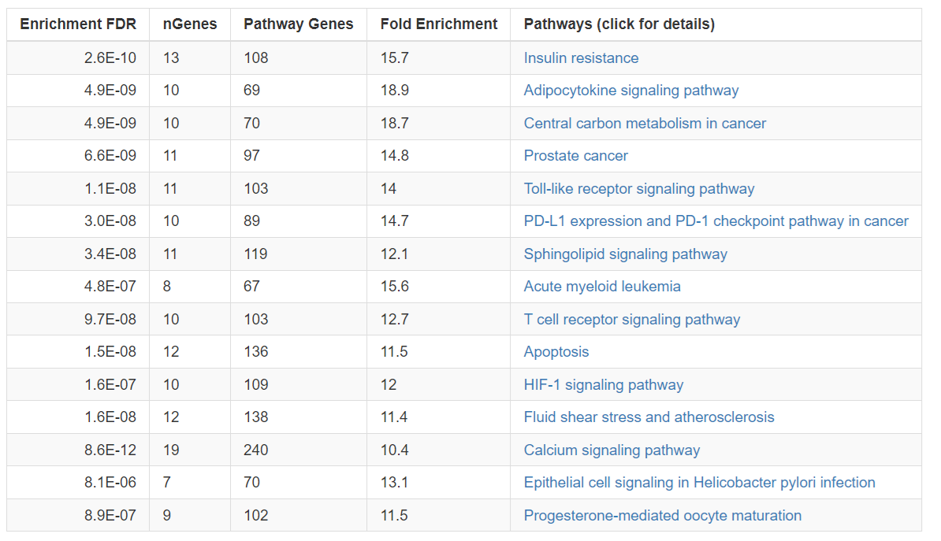
Enriched pathways based on all genes from Super-PRED
Total 190 unique genes predicted by Super-PRED for enrichment analysis
Insulin resistance, Adipocytokine signaling pathway, and central carbon metabolism cancer are the most enriched biological terms.
Notes:
LNPEP DCTPP1 CDC25C DPP8 LDHA TOP2A ATG4B NNMT DDR1 RPS6KA5 TRIM24 F10 KLF5 KAT6A SCD SLC1A1 GPR17 CPT1B GPR35 CFD FASN GRIN1 NR1I2 ACACB
PRMT6 PKN1 QRFPR ADAM10 CYP19A1 STAT3 TERT NTRK1 S1PR5 P2RX7 KCNH2 DUT DDR2 GHSR MAPK11 SLC1A3 MAOA CHRNA7 NFE2L2 GLS IL23R YES1 NTSR2
PTGDR2 PIK3CD CDK2 FYN HDAC10 RAB9A CYSLTR2 GSTP1 CHRM5 GRK5 AOC3 BCHE HTR7 SLC6A9 NOS2 CHRNB4 PARP2 AURKB CAPN1 CDC25B LYN NOS3 CES1
PTPN1 STING1 CCR2 CHKA FCGRT FOLH1 PPARA RPS6KA1 FRK TDP2 ADORA1 ACHE NR1H4 PTK2B CSK GGPS1 GLO1 CSNK2B HIF1A HRH3 HSP90AB1
CACNA1H MAP3K8 GPBAR1 GLRA1 PTPN2 DUSP3 STK3 PDE11A PRCP MIF CDK5 TACR2 KCNK9 CES2 CACNA1B MAP2K2 F13A1 ABCB1 KAT2B ADORA2B
KIF11 PRKAA1 HSD11B2 TDP1 TFPI PPARG TLR8 MAOB NR4A1 METAP2 SLC1A2 TMPRSS6 ITK PTGS1 KIT KDM4A SCN4A CDK7 MARK4 FFAR4 KEAP1
PARP1 S1PR4 CYP2A6 KLK5 TRPA1 ABCC1 PTPN11 APEX1 FLT1 NTRK3 MST1R KLK7 EPHB2 GPR55 PRKACA NOS1 SCN3A SLC6A5 TNK1 PSMB2 ULK3 HCK
HSP90AA1 CHUK RORB TLR7 FER AKR1B1 CTSB PDE3B MELK NFKB1 NR3C1 AHCY CSNK1E CTSD GABRA1 AXL PIK3R1 NPC1 PDGFRB MMP8 HSD17B10
HTR2A CTSK SLC6A4 GBA2 TOP1 ERAP1 HDAC8 BRDT IKBKB ICMT HTR2C SOAT1 GPR6 SLC2A1 WDR5

Slide 19
Summary of the first approach
SLC2A1, CDC25C, LYN, and ACHE are important genes based on scientific evidence. All of them have a prediction probability above 60% with model accuracy above 75%.
Each of the compounds NCGC00685517, NCGC00602080, and NCGC00686269 includes three of these genes, while NCGC00685598 includes two genes from SLC2A1, CDC25C, LYN, and ACHE.
Muscle contraction, response to stress, autosomal dominant inheritance, and depression are the most important enriched biological terms based on scientific evidence.

Slide 20
Target Deconvolution via Similar Compounds

Slide 21



DYT1 dystonia
Scientific evidence
-Annotation checking
-Number of papers
-Concurrency
Scientific evidence
-Annotation checking
-Number of papers
-Concurrency
Scientific evidence
-Annotation checking
-Number of papers
-Concurrency
Screening compound
CHEMBL
Similar compounds
CHEMBL
Phenotypes
Genes
Diseases
https://hpo.jax.org/data/annotations

Slide 22
Gene association identification for similar compounds
Similar Compounds | Associated genes from ChEMBL
CHEMBL1372162 | TGR; ampC; TARDBP; EHMT2; CBX1; NFE2L2; TDP1
CHEMBL1367890 | TDP1; GMNN; PTH1R; SMAD3; CGA
CHEMBL1733809 | CGA; EHMT2
Compound CID: 16022698
Tanimoto coefficient > 0.8
TOR1A

Slide 23
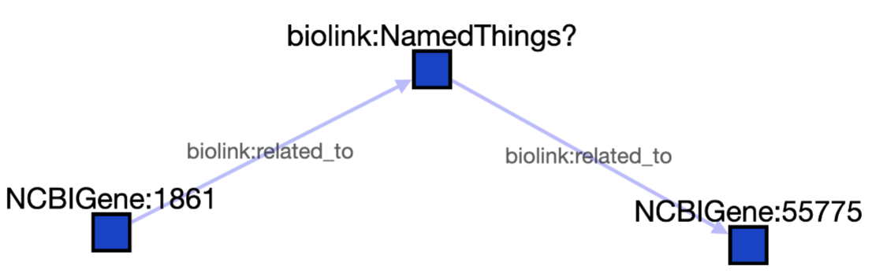
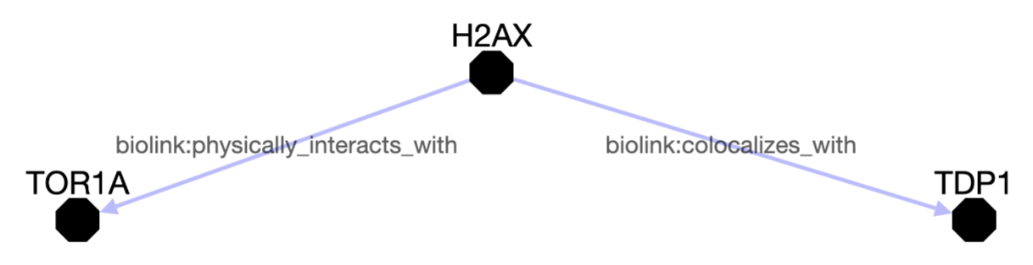

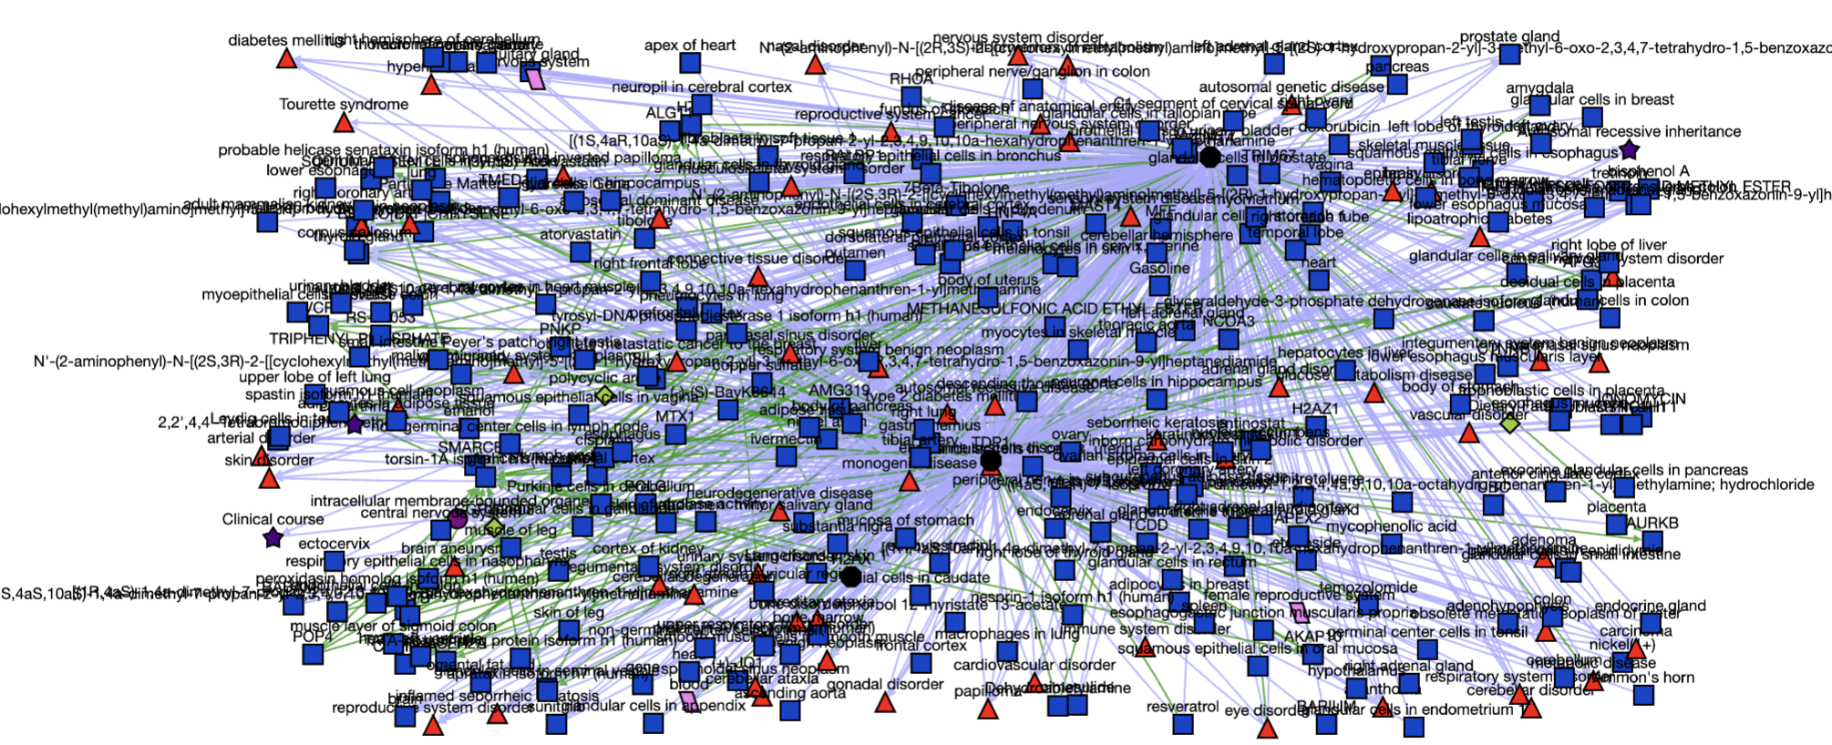
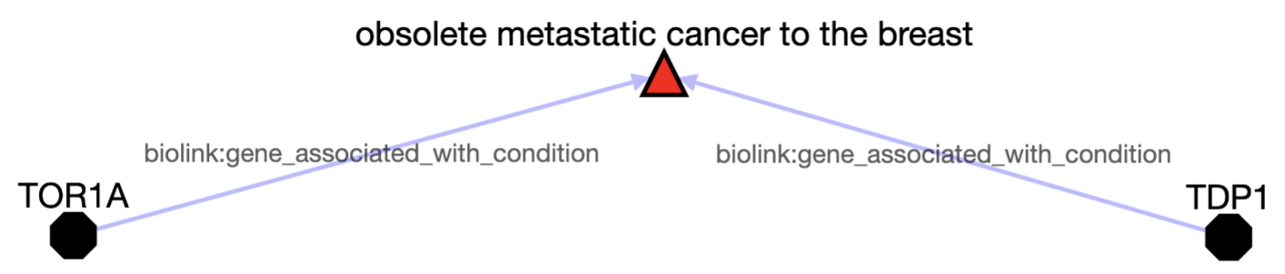
Scientific evidence mining via Translator
TDP1 and TOR1A (https://arax.ncats.io/?r=abc51579-8313-4e71-90c4-c38d769adef9 )
329 potential associations

Slide 24
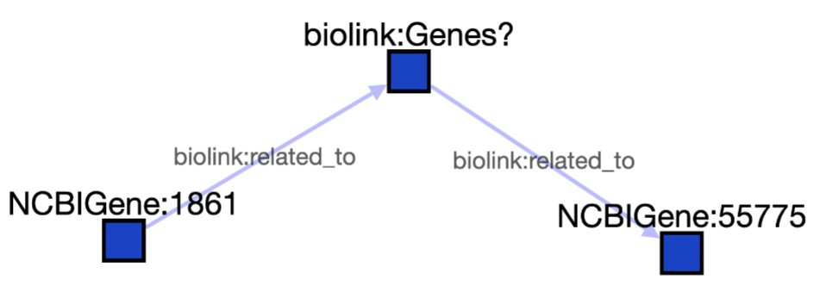
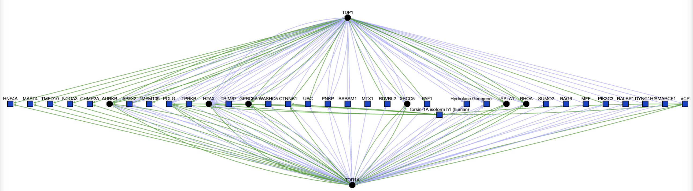
TDP1 and TOR1A (https://arax.ncats.io/?r=7acf41e8-82e2-4a31-8c5e-e594d1ab0ea4 )
34 potential associations via intermediate genes

Slide 25
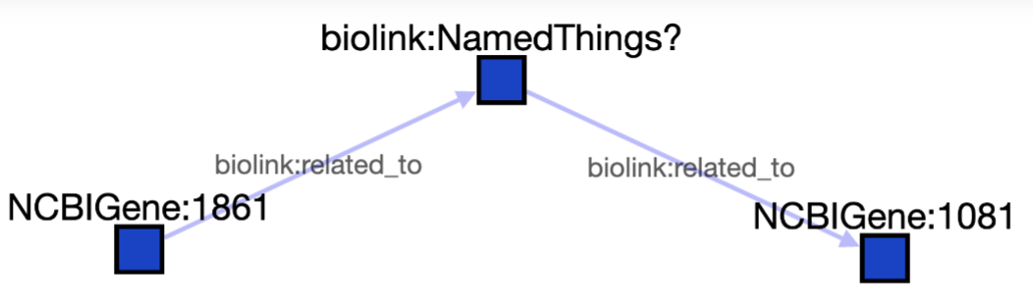
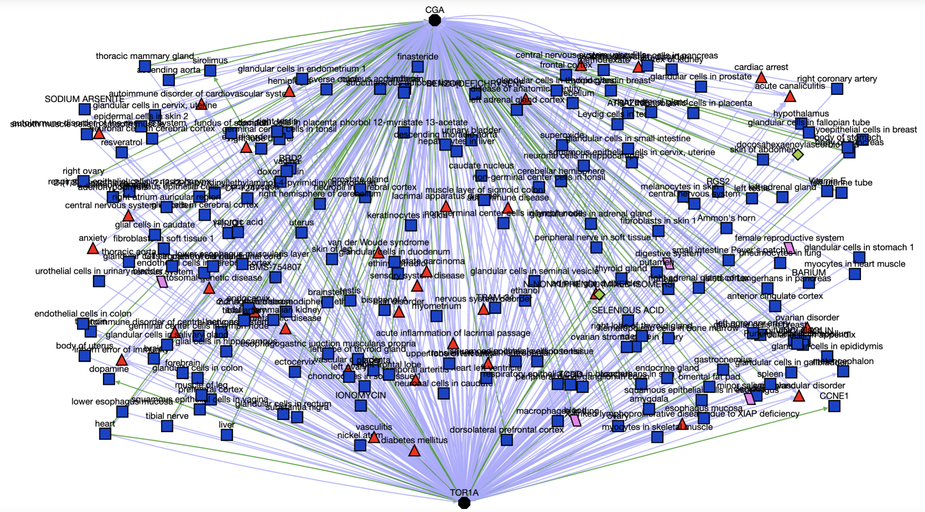
CGA and TOR1A (https://arax.ncats.io/?r=30b5f5b8-07fb-422f-86eb-36e48d5b931c )
223 potential associations

Slide 26
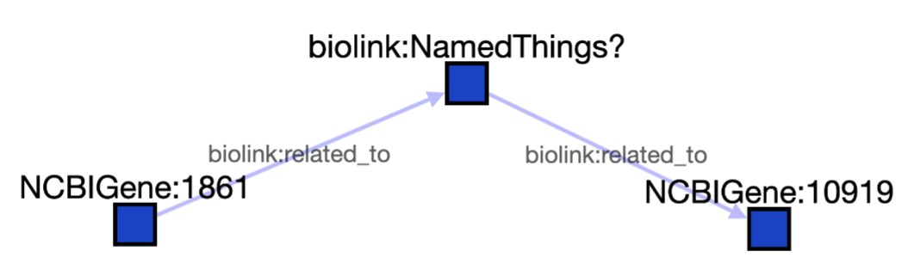
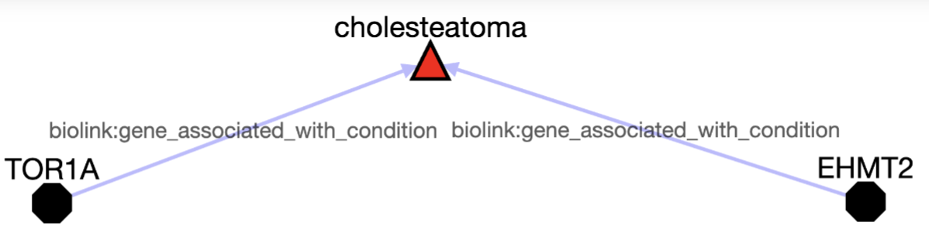
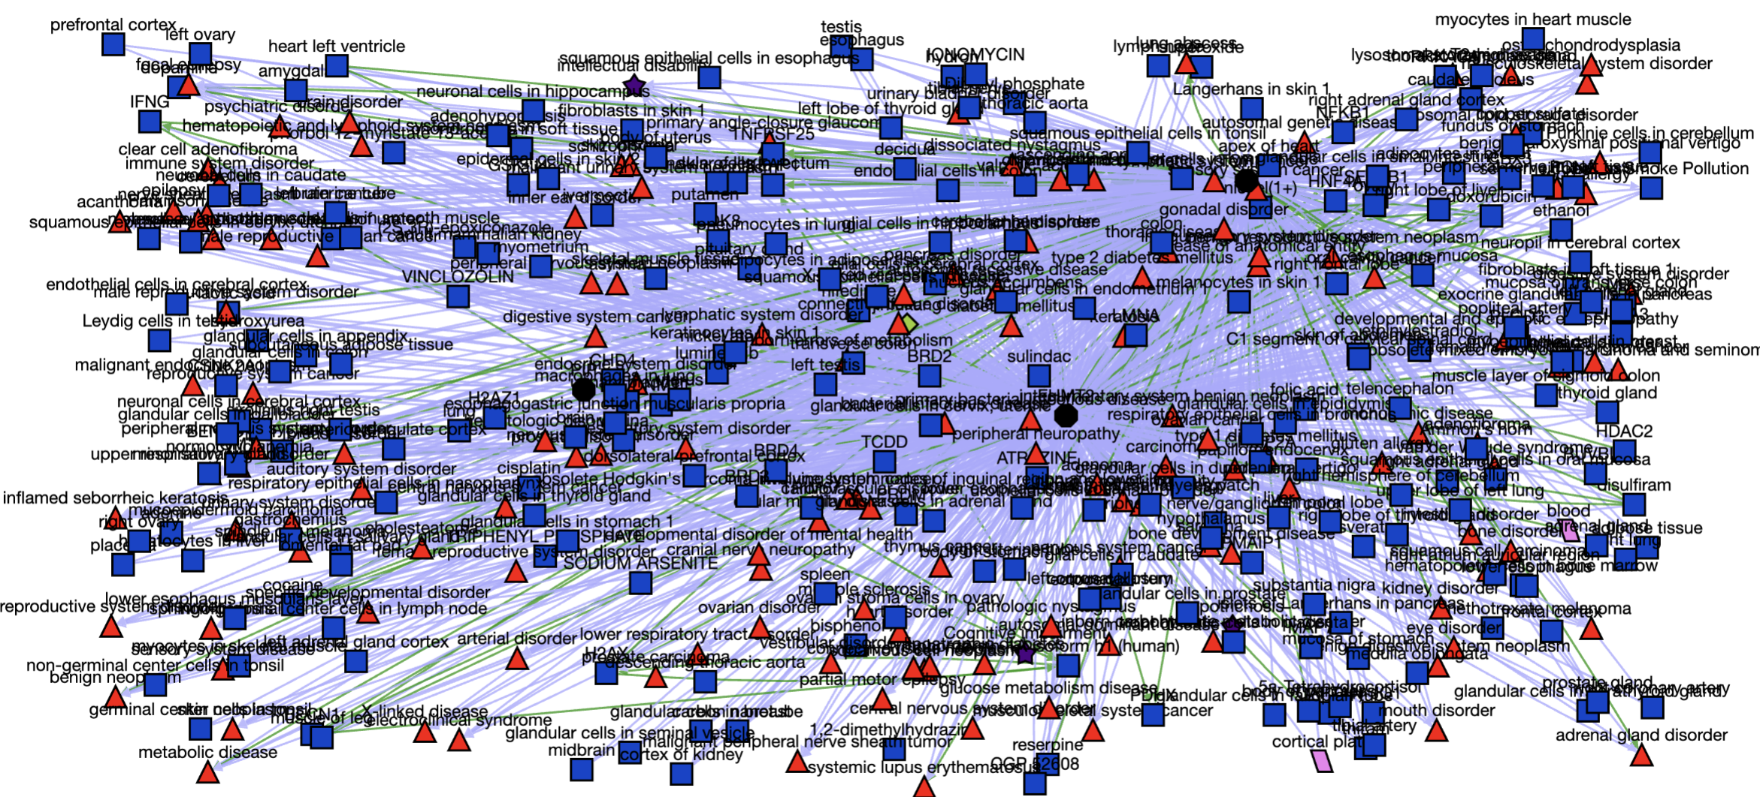
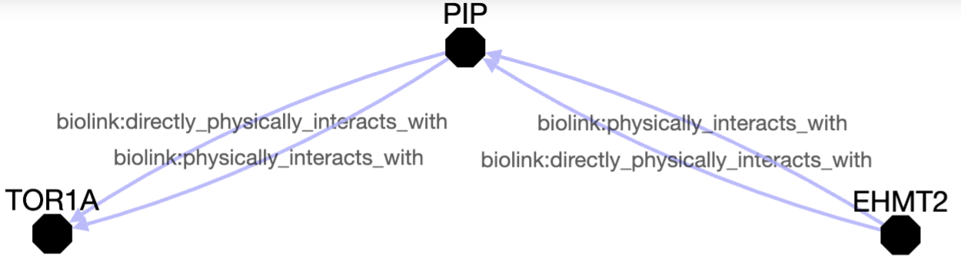
EHMT2 and TOR1A (https://arax.ncats.io/?r=5084c268-2f9c-4a16-85a1-2fe8ab499818 )
473 potential associations

Slide 27
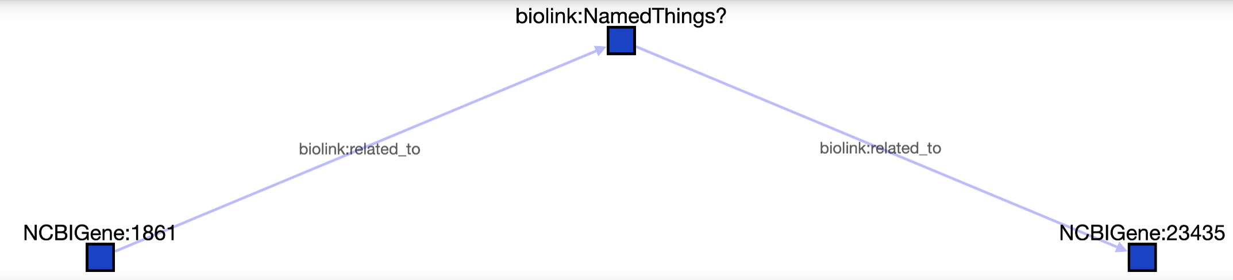
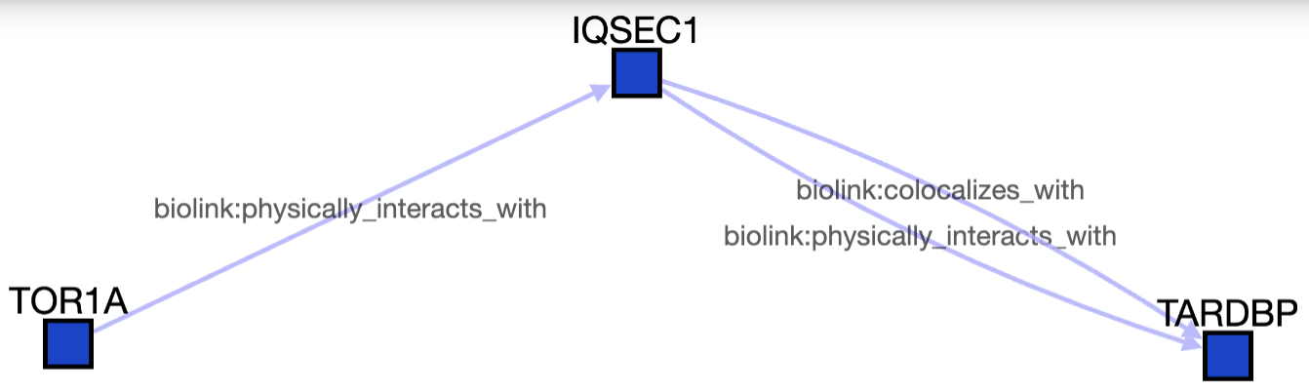
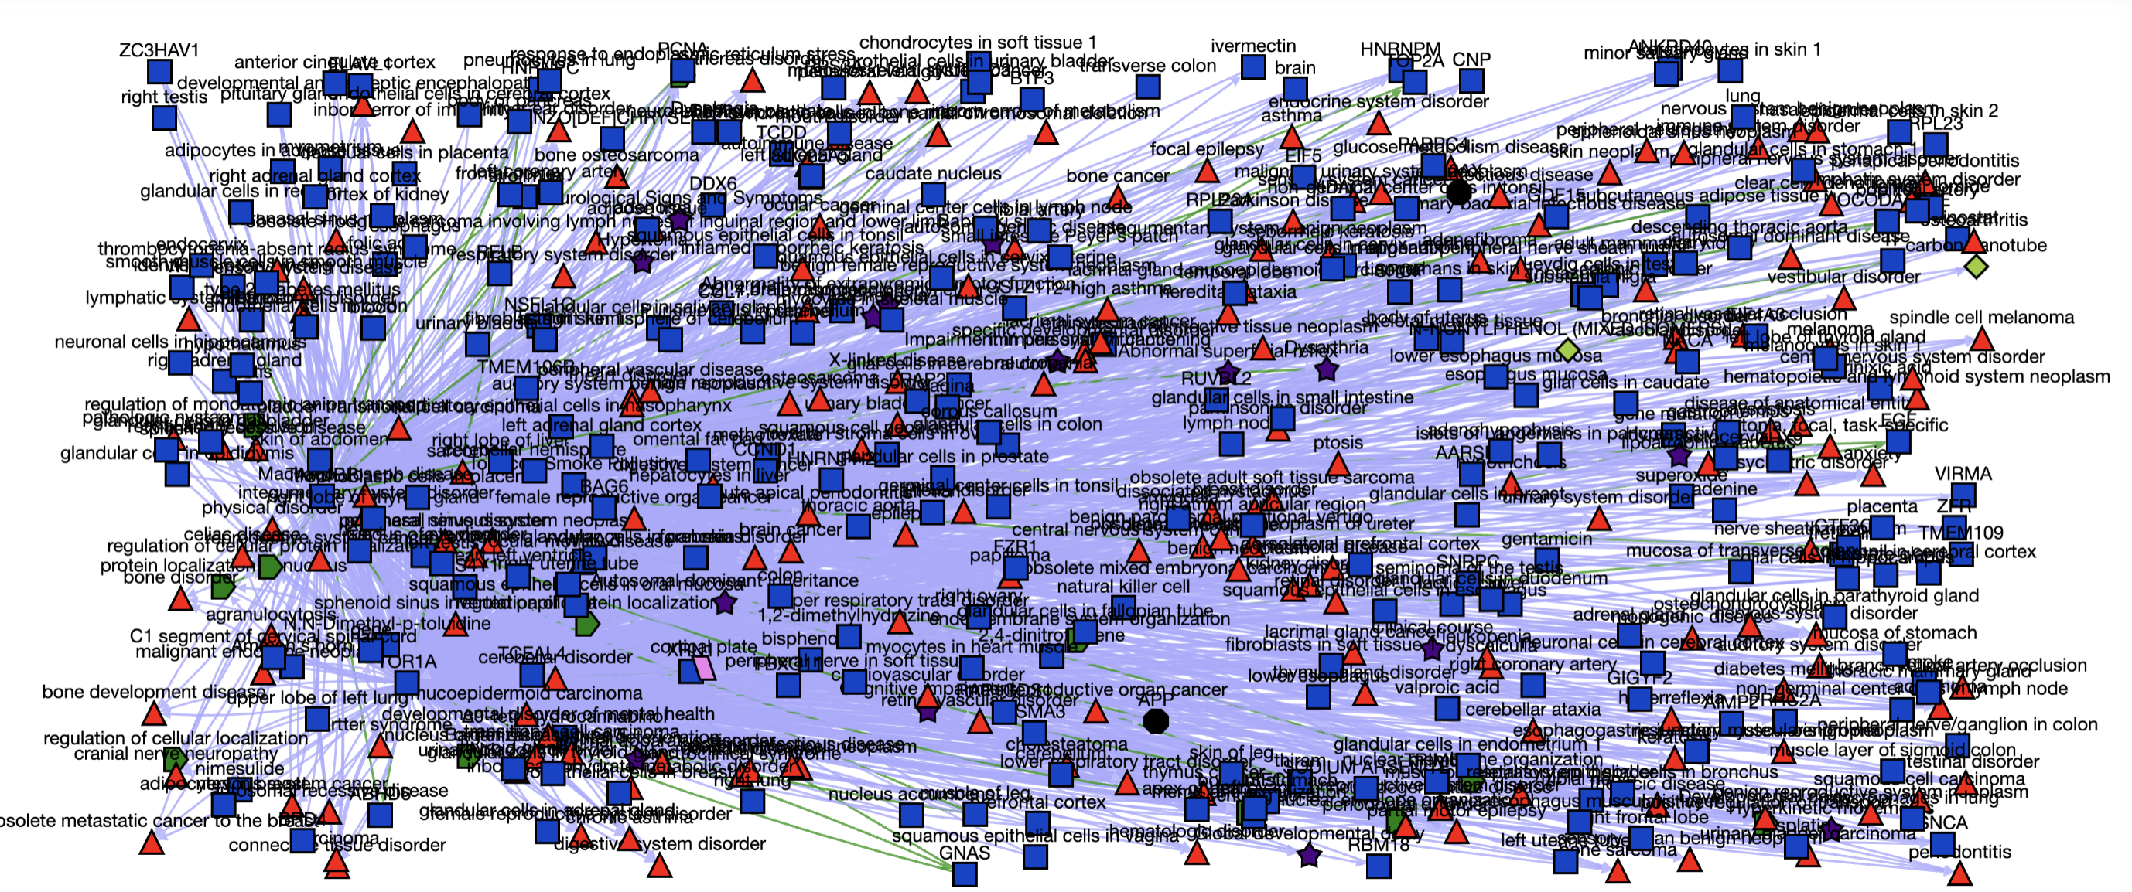
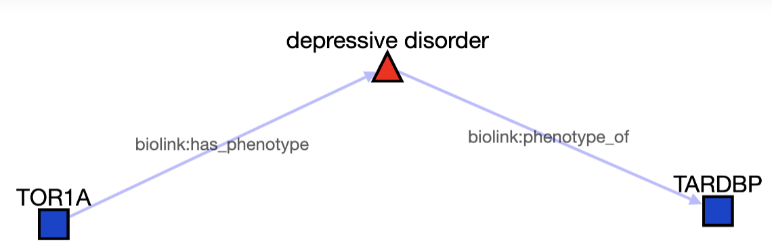
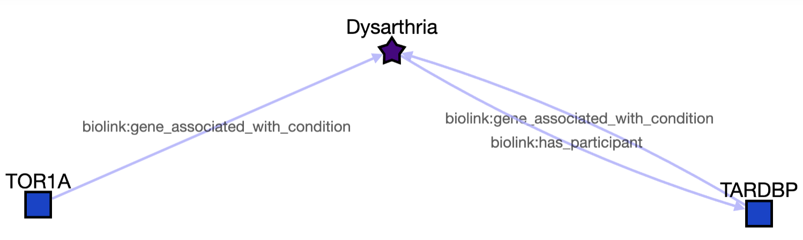
TARDBP and TOR1A (https://arax.ncats.io/?r=319af68a-9987-45dc-abd0-596db230ede0 )
473 potential associations

Slide 28
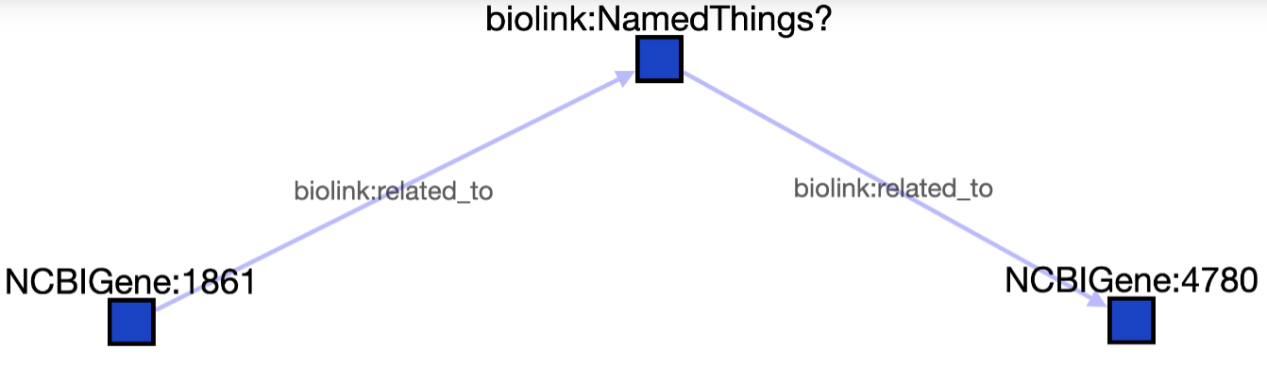
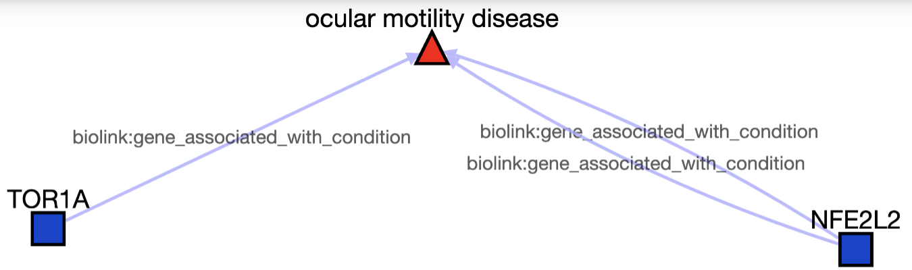
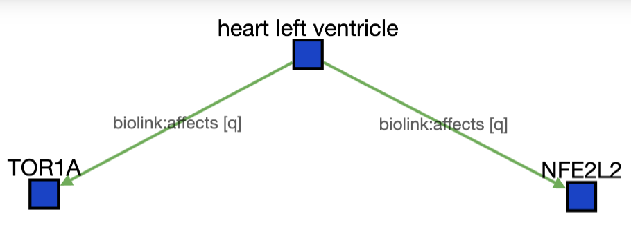
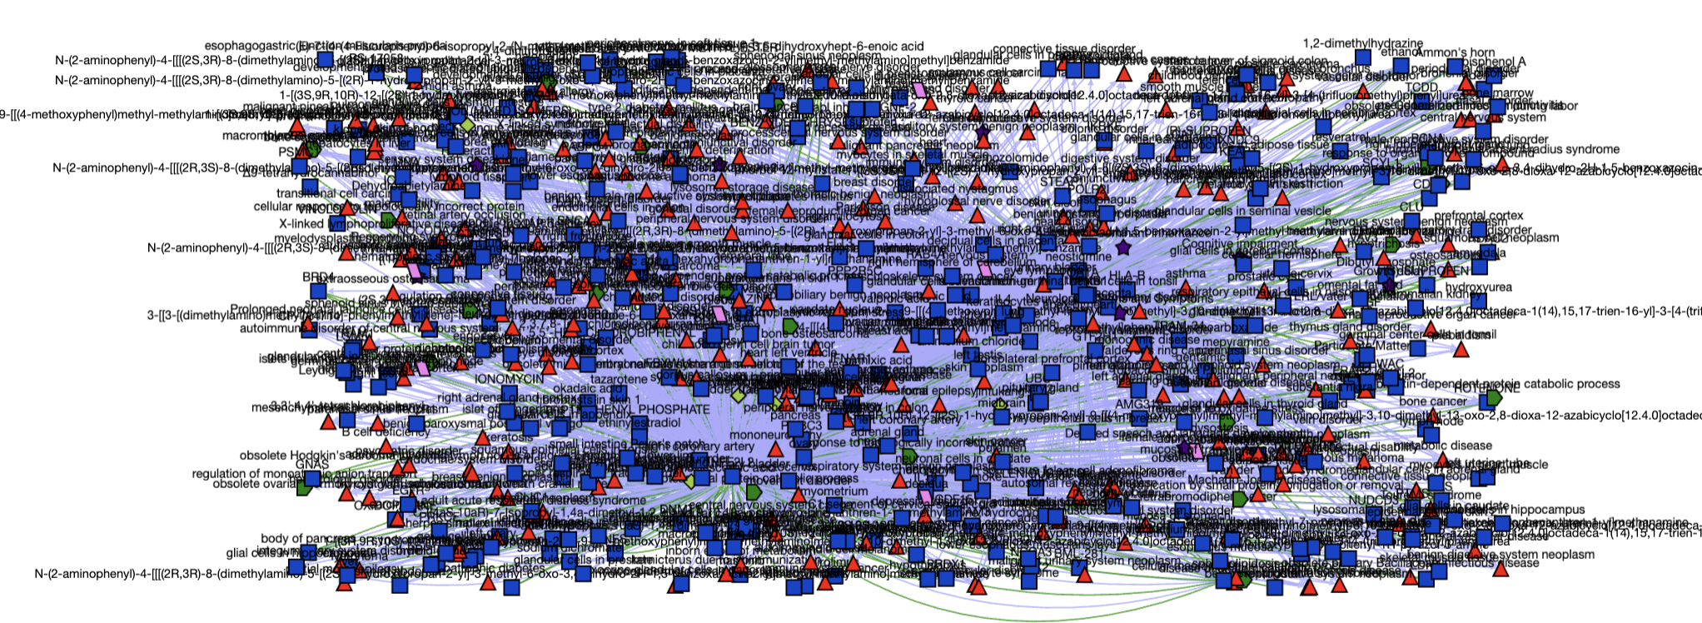
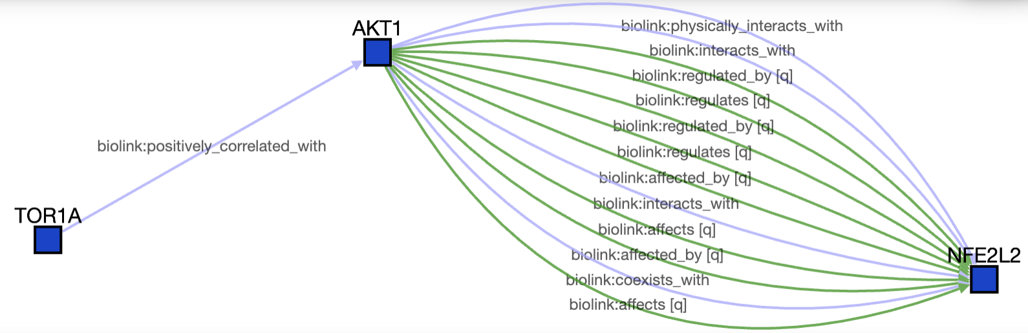
NFE2L2 and TOR1A (https://arax.ncats.io/?r=53eba960-351d-47f6-911f-bde491000947 )
483 potential associations

Slide 29
Phenotype association identification
Genes | Phenotypes | # Literature based on annotations | Co-occurrence in sentences
SMAD3 | Stroke | 2
 | Hypertension | 2
 | talipes equinovarus | 1
 | scoliosis | 1
 | Cardiac arrest | 1
GMNN | microcephaly | 3
TDP1 | ataxia | 6 | 22345219, 22345219
 | cerebellar atrophy | 4
NFE2L2 | tremor | 31 | 22266882, 30244176, 34264428, 29053766, 21907099, 8232931, 9440801, 650244, 29053766, 30244176
 | Short stature | 2
TARDBP | respiratory failure | 6 | 1985454,11523,22132914,24262166,15390042,22266882,10979329, 19578124,24092288, 10720299
 | parkinsonism | 15
 | pain | 15 | 35955710, 35955710, 35955710,35955710
 | neurodegeneration | 7 | 12785748, 22132914, 32516804, 19457118,32516804
 | depression | 6 | 15326234, 33991565, 34398825, 34398825, 33991565
 | anxiety | 4
 | dysphagia | 2
 | muscle spasm | 1 | 16275837
 | spasticity | 1
 | dysarthria | 15
EHMT2
CGA
SMAD3
CHEMBL1733809
PTH1R
GMNN
CHEMBL1367890
TDP1
CHEMBL1372162
NFE2L2
CBX1
TARDBP
ampC
TGR

Slide 30
Disease association identification
EHMT2
CGA
Genes | Diseases | Literature based on annotations | Co-occurrence in sentences
TARDBP | Orphanet: Amyotrophic lateral sclerosis | 24311730 | TorsinA rescues ER-associated stress and locomotive defects in C. elegans models of ALS
 |  |  | Here we explore the potential for torsinA to serve as a buffer to attenuate the cellular consequences of misfolded-protein stress as it pertains to the neurodegenerative disease amyotrophic lateral sclerosis (ALS).
 |  |  | These results expand our understanding of proteostatic mechanisms influencing neuronal dysfunction in ALS, while simultaneously highlighting the potential for torsinA as a novel target for therapeutic development
SMAD3
CHEMBL1733809
PTH1R
GMNN
CHEMBL1367890
TDP1
CHEMBL1372162
NFE2L2
CBX1
TARDBP
ampC
TGR

Slide 31
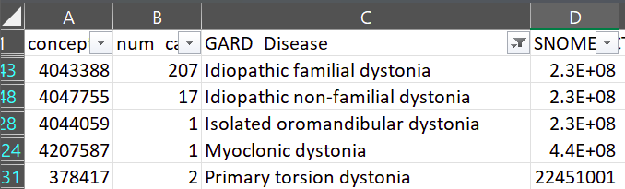
More we can do……
Applying more other data resources
Mining clinical data and genomics data at All of Us
Developing machine learning/deep learning models
Exploring Large Language Model (LLM) for extra evidence if applicable

Slide 32


